Slide 1
Internet-VPN Implementation
1. JCB Network Internet-VPN with IPsec
2. Questionnaire-A
3. Questionnaire-B
4. IP address and parameter for IPsec
2018 /February

Slide 2





1.1 Internet-VPN Overview
In general, IPsec is used as the encryption method for the Internet VPN. IPsec protects user‘s data from eavesdropping, tampering and spoofing attacks. It is the encryption technology that plays a central role in data protection
Exchange Secure ‎Secret key
Eavesdropping
Site to Site Connection
Data Encryption（3DES，AES etc）
VPN Device
（Hardware）
Internet
Encryption
IPsec VPN
IPsec VPN
VPN Device
（Hardware）
Encryption
‎Falsification
of data
Remote Access
Message Authentication
（Keyed MD5, Keyed SHA etc）
VPN Client
（Software）
Spoofing
User Authentication
（pre-shared key,
‎Digital certificate, Xauth)

Slide 3
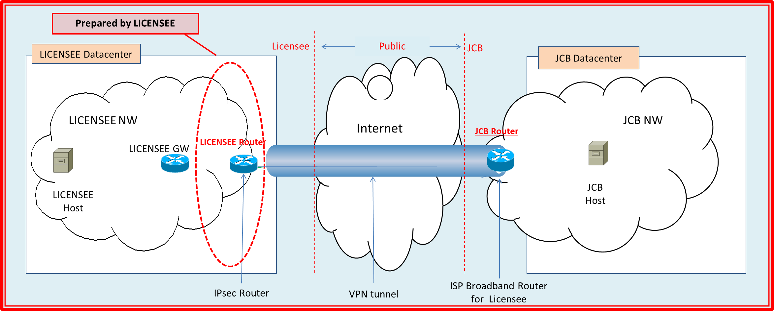
1.2 JCB Network Internet-VPN with IPsec
<Licensee’s Tasks>
■ IPsec Router : Licensee should provide the router to be used for IPsec.
■ Environment: Licensee must arrange to have working Internet connection.
<JCB’s Tasks>
■ Expected time of installation: It will take 1.5 to 2 months for JCB to install the Internet VPN connection after licensee agrees with the document defining the IP address configuration between JCB and licensee (IP Exchange Rule).
■ IP Exchange Rule: This is a document containing the IP address exchange diagram and defines all the required parameters to establish connection between JCB and licensee. JCB will create this document and submit to licensee for approval.
■ Pre-shared key for VPN: JCB will send the pre-shared key for VPN to the licensee.

Slide 4
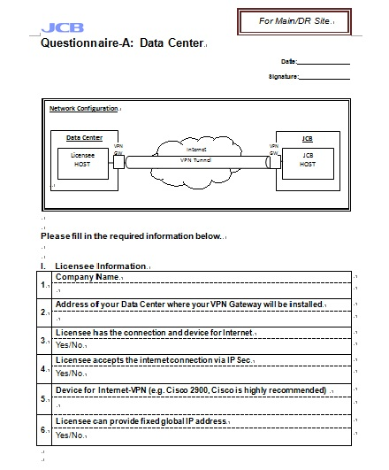
sample
2. Questionnaire-A
SAMPLE
Fill in all the required licensee information in Questionnaire A.
Please complete all fields and do not leave any blanks.
This document will be used as basis for determining the expected completion time of the Internet VPN installation.
After completing all fields, promptly submit this document to JCB in data form.

Slide 5
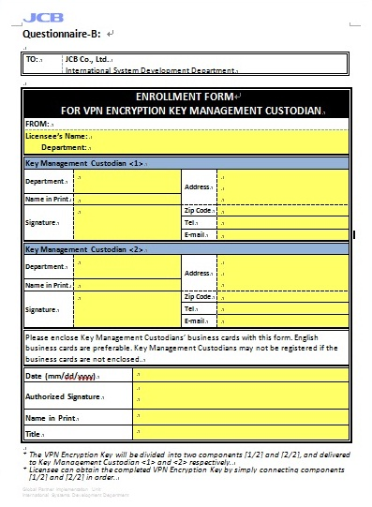
3. Questionnaire-B
SAMPLE
Accomplish Questionnaire B to enroll the VPN encryption key management custodian of the licensee.
Please complete all fields and do not leave any blanks.
If only one custodian is available, write the name
and information of the same person in Key
Management Custodian <1> and <2>.
After completing all fields, promptly submit this document to JCB in data form.

Slide 6
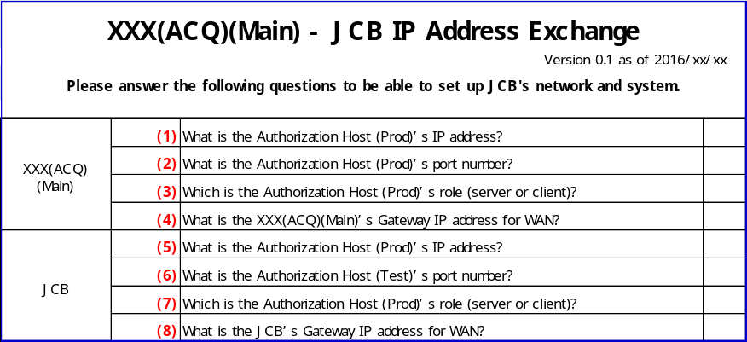
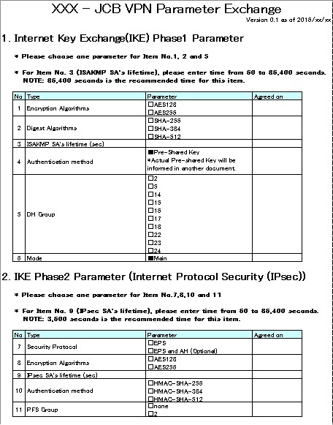
4. IP address and parameter for IPsec
SAMPLE
SAMPLE
■ As prerequisite to the IP rule agreement, licensee needs to submit the IP Address Exchange and VPN Parameter Exchange to JCB.
Please complete all fields and do not leave any blanks.
If you have any questions regarding the forms, please contact JCB.
After completing all fields, promptly submit this document to JCB in data form.

